Slide 1


Slide 2
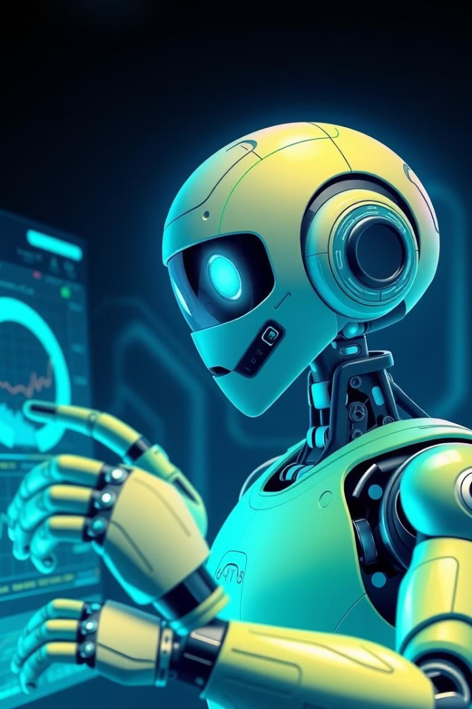
Car Selling Price Prediction Using Machine Learning
Project by Muhammad Sudais Khalid
BSAI-23F-0050
BS Artificial Intelligence, Semester 3
Instructor: Sir Muhammad Tahir

Slide 3
Project Introduction
Objective
Key Features
Predict used car selling prices using machine learning
Year of manufacture
Kilometers driven
Fuel type
Seller type
Transmission type

Slide 4
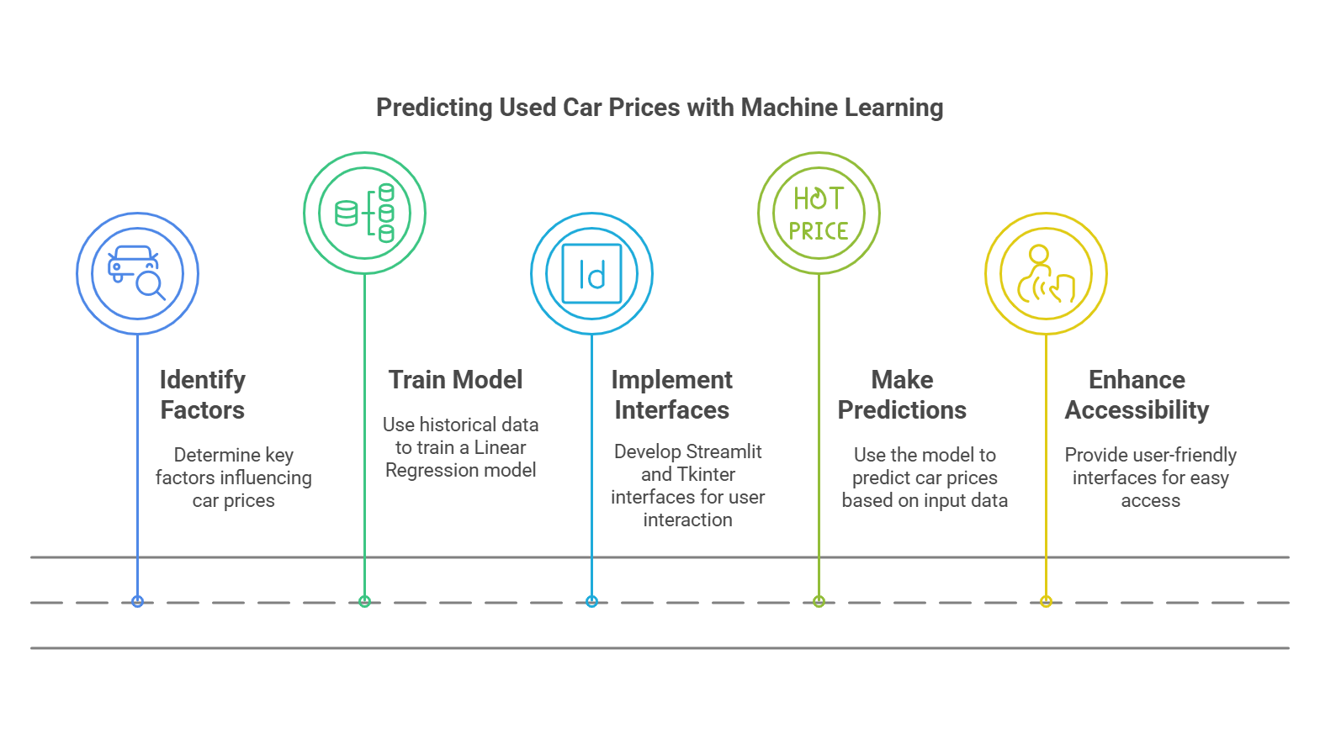
Visual Introduction

Slide 5
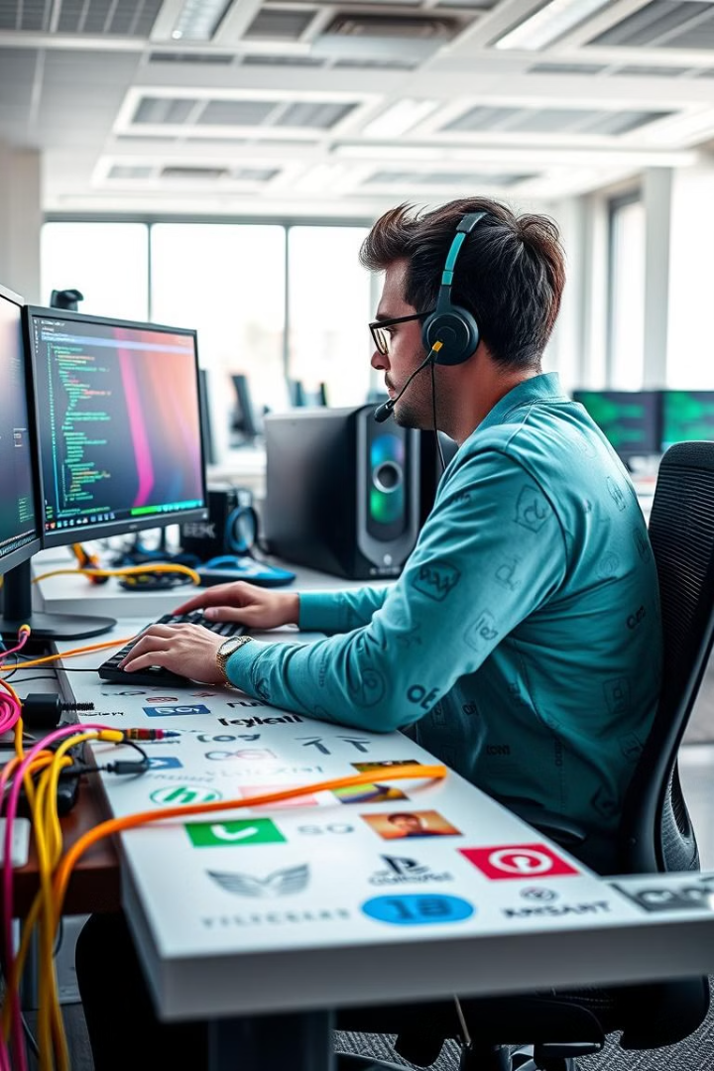




Technologies Used
Python
scikit-learn
Programming language for development
Machine learning library for model implementation
Pandas
Streamlit
Library for data handling and manipulation
Library for web-based GUI development

Slide 6
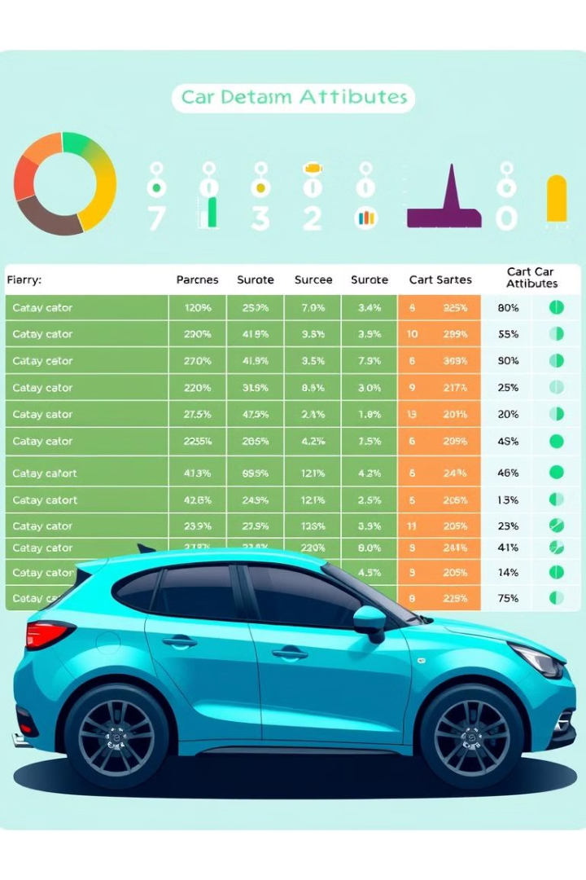
Dataset Description
Car_Name (Dropped)
Year (Manufacturing Year)
Present_Price (Current Market Value)
Kms_Driven (Distance Traveled)
Fuel_Type (Petrol, Diesel, CNG)
Seller_Type (Dealer, Individual)
Transmission (Manual, Automatic)
Owner (Number of Previous Owners)
Selling_Price (Target Variable)

Slide 7




Data Preprocessing & Model Implementation
Data Preprocessing
Removed Car_Name
One-hot encoding categorical variables
Split dataset: 80% training, 20% testing
Model Implementation
Linear Regression using scikit-learn
Evaluation
Used Mean Squared Error (MSE) metric

Slide 8
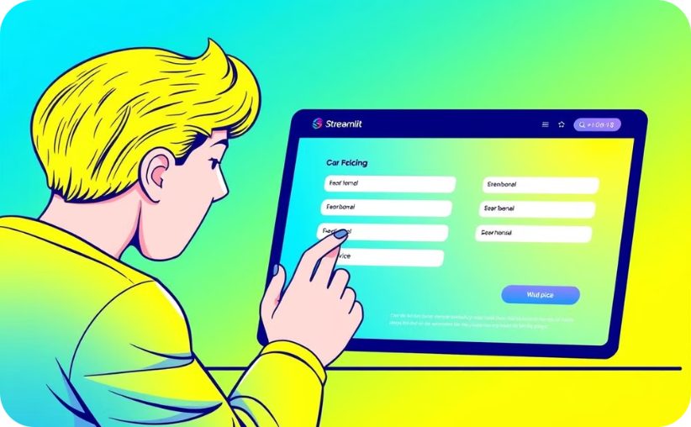
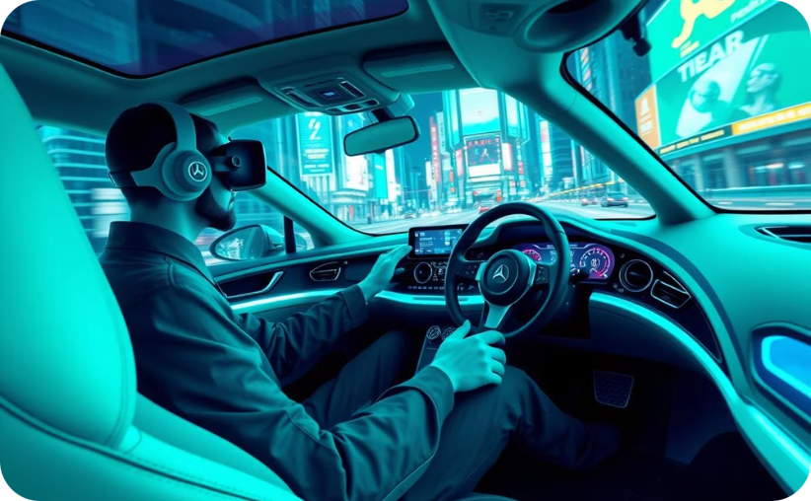
GUI Implementation
Streamlit (Web-based UI)
Tkinter (Desktop Application UI)
Simple web interface for user input
Graphical desktop app with dropdowns and fields
Displays predicted price and model metrics
Shows prediction result directly on interface

Slide 9
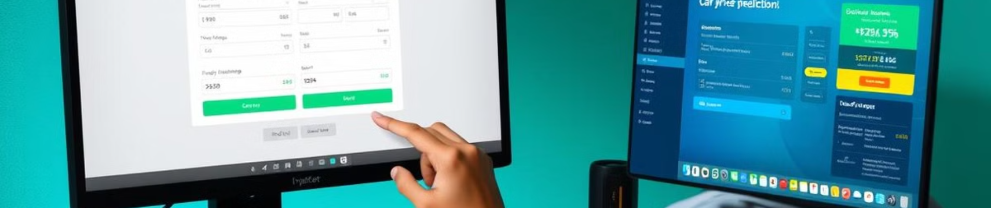
Results & Evaluation
Model Performance
User Accessibility
Reasonable accuracy in price prediction
Streamlit and Tkinter for user-friendly experience
Measured using Mean Squared Error (MSE)
Users can estimate car prices via both GUIs

Slide 10
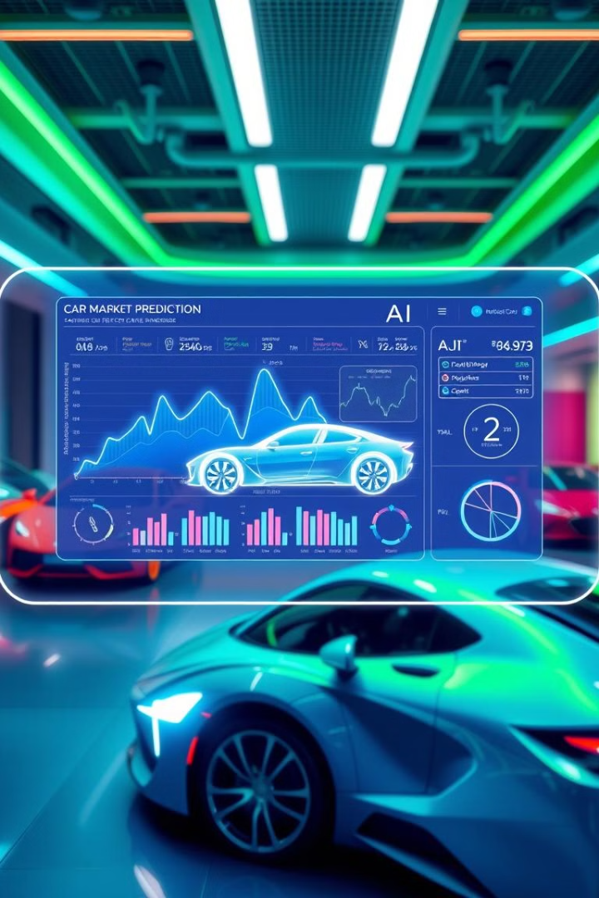
Conclusion & Future Scope
1
Conclusion
Successful machine learning implementation for car price prediction
Dual GUIs enhance project accessibility
2
Future Scope
Advanced models like Random Forest, XGBoost
Add more features: location, brand, condition
Integrate a database for user inputs and predictions
Collaboration with Pakwheel

Slide 11
Thank You
Keep Growing & Smiling

